Slide 1
What non-linear simulations can teach us about ELM physics
Matthias Hoelzl,

Slide 2
Outline
Motivation: Why ELMs? Why non-linear simulations?
JOREK:
What is the non-linear MHD code JOREK?
Which physics questions are being investigated?
Type-I ELMs:
Agreement between simulations and experiments?
Role of plasma flows and mode coupling
Loss mechanisms
Control: Basic mechanisms behind the methods?
Conclusions: Open questions and plans?

Slide 3
Motivation:
Why ELMs?
Why non-linear simulations?

Slide 4
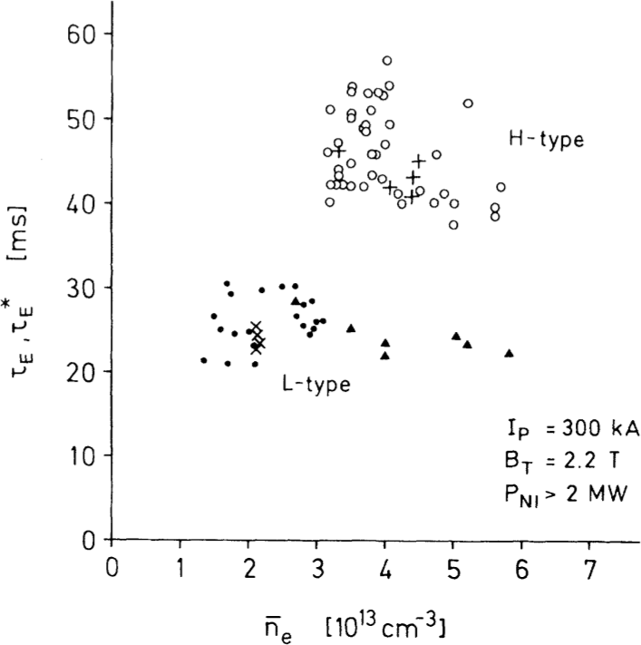
H-Mode and ELMs
H-Mode first observed in ASDEX divertor tokamak
Transport barrier leads to formation of pressure pedestal at the edge
Improved confinement
„Short bursts […] which lead to periodic density and temperature reductions in the outer plasma zones.“
[F Wagner et al, PRL 49, 1408 (1982)]

Slide 5
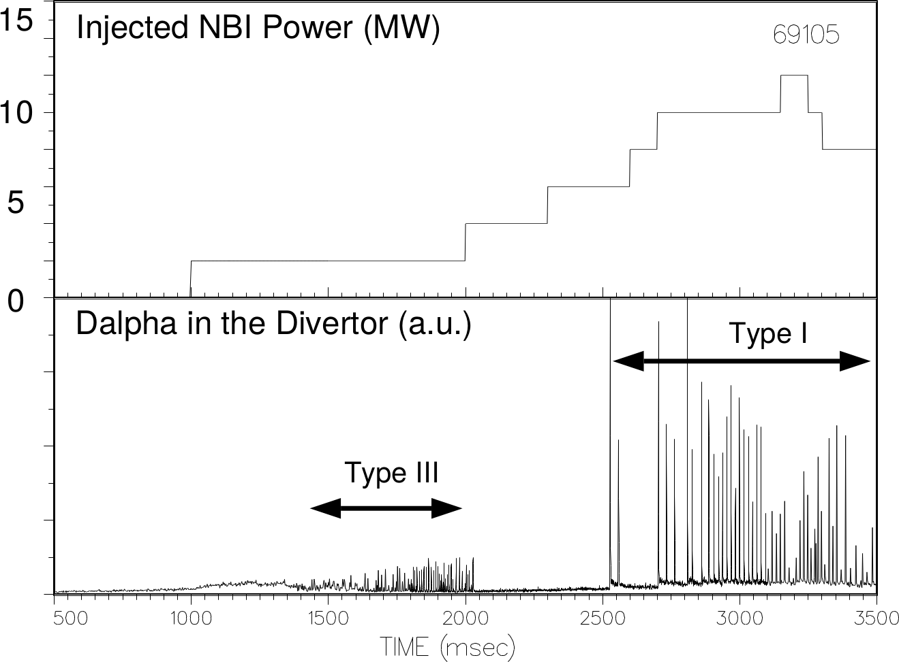
Classification of ELMs
Different types of Edge Localized Modes observed
Type-I ELMs can lead to a release of ~10% of the plasma energy within several hundred microseconds
[EJ Doyle, et al, Phys Fluids B 3, 2300 (1991)] [H Zohm, et al, PPCF 38, 105 (1996)] etc

Slide 6
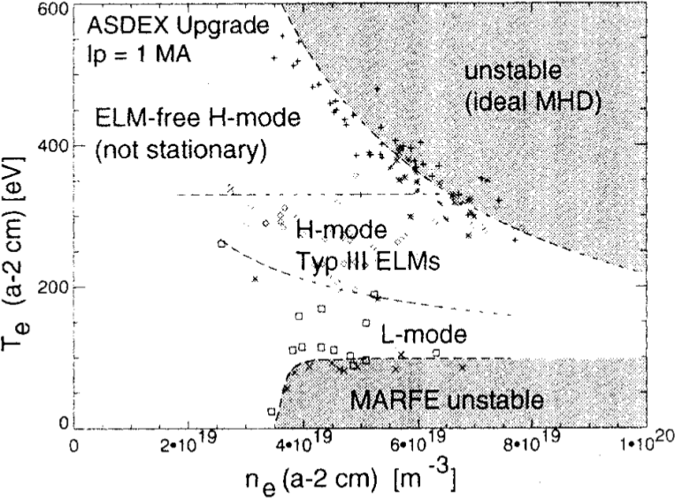
Peeling-Ballooning Modes
Type-I ELMs are linked to ideal ballooning modes driven by large pressure gradients [P Gohil et al, PRL 61, 1603 (1988)] [GTA Huysmans et al, 22nd EPS (1995)] [JW Connor, PPCF 40, 531 (1998)] [PB Snyder, NF 44, 320 (2004)]
Also current driven peeling modes play a role due to the large bootstrap current

Slide 7
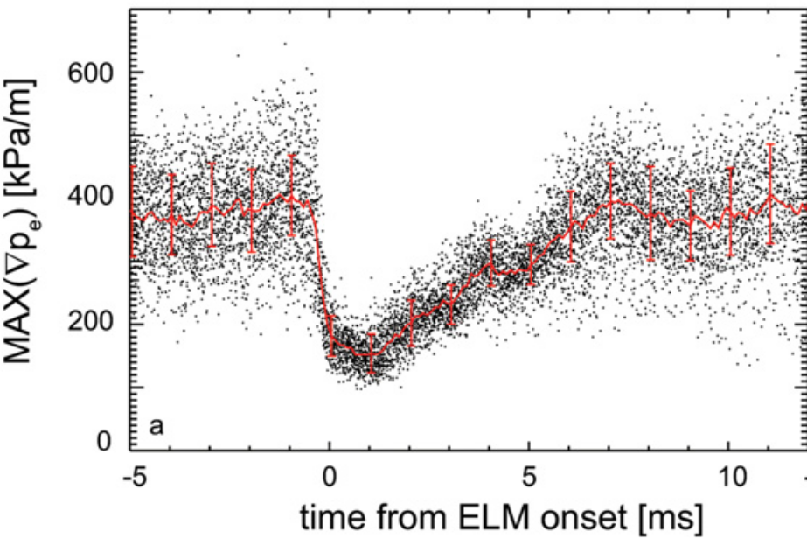
Before the ELM
Pedestal builds up
Maximum pressure gradient often remains constant for several milliseconds before the ELM crash [R Groebner et al, NF 49, 045013 (2009)] [A Burckhart et al, PPCF 52, 105010 (2010)]
EPED: Kinetic ballooning modes clamp pressure gradient while pedestal width keeps growing [PB Snyder et al, PoP 19, 056115 (2012)]
Experimental evidence for edge modes developing at the time of pressure gradient clamping [A Diallo et al, PRL 112, 115001 (2014)] [FM Laggner et al, PPCF 58, 065005 (2016)]

Slide 8
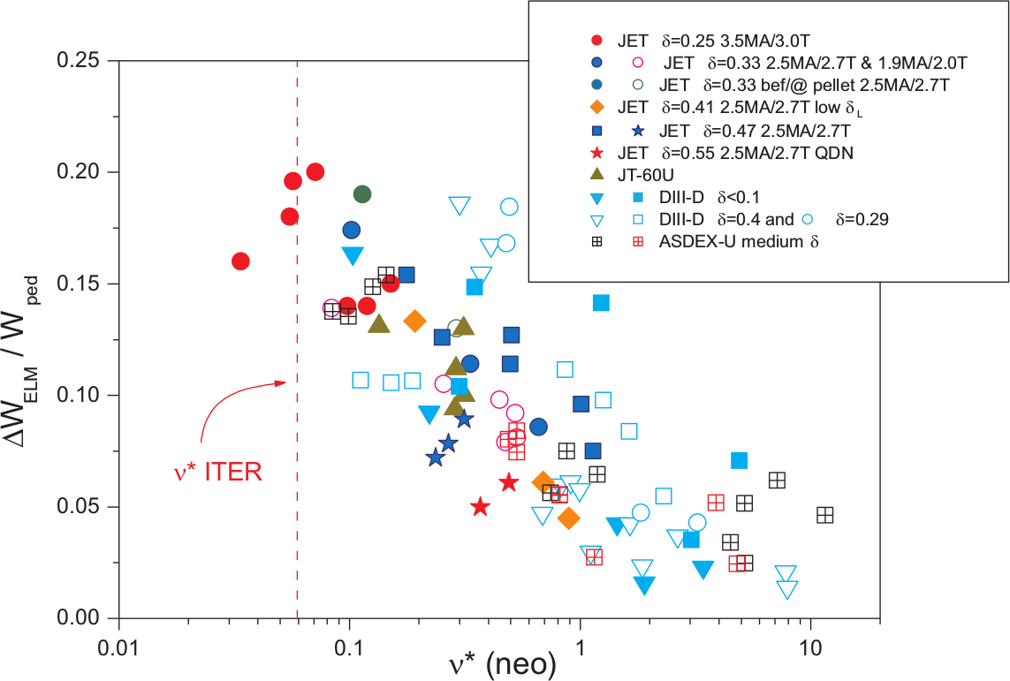
Why ELMs?
Losses increase at low collisionality [A Loarte et al, PPCF 45, 1549 (2003)]
Fast timescale (several hundred microseconds to few milliseconds)
Localized deposition
Large peak heat fluxes
Risk of reduced divertor life-time in ITER
Frequent ELMs important for impurity exhaust
Basic understanding
Control mechanisms

Slide 9
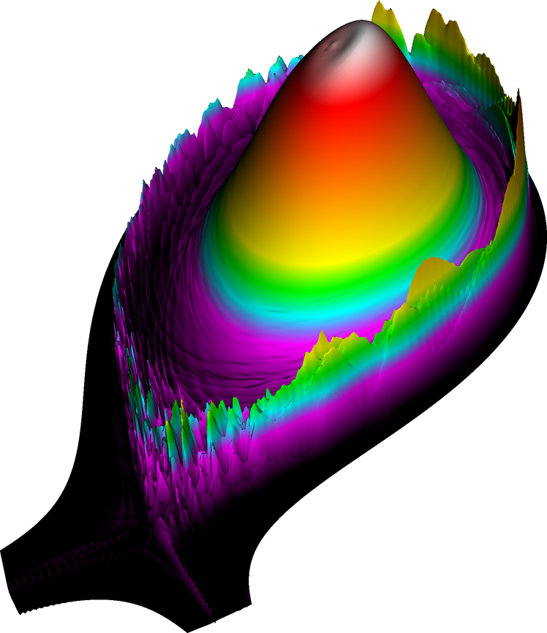
Non-linear simulations of ELMs
Non-linear MHD codes used for studying ELMs in realistic X-point geometry: M3D, BOUT++, JOREK, NIMROD [GTA Huijsmans et al, PoP 22, 021805 (2015)]
Main challenges:
Spatial scales (Lundquist number)
Different Timescales
Large relative fluctuations
A typical simulation requires ~500-5000 compute node hours
Current perturbation during a JOREK ELM simulation for ASDEX Upgrade
(0.73ms)

Slide 10
JOREK:
What is the non-linear MHD code JOREK?
Which physics questions are investigated?

Slide 11
JOREK: Physics Models
Reduced MHD; ideal wall and divertor sheath boundary conditions [GTA Huysmans and O Czarny, NF 47, 659 (2007)]
Free boundary extension [M Hoelzl et al, JPCS 401, 012010 (2012)]
Two-fluid + neoclassical physics [F Orain et al, PoP 20, 102510 (2013)]
Pellet ablation model [S Futatani et al, NF 54, 073008 (2014)]
Full orbit particle tracer [DC van Vugt, et al, 44th EPS, P2.140 (2017)]
Full MHD [JW Haverkort et al, JCP 316, 281 (2016)]
Guiding center particle tracer [C Sommariva et al, NF (submitted)]
Relativistic electron fluid model [V Bandaru et al (unpublished)]
Neutrals model [A Fil et al, PoP 22, 062509 (2015)]
Impurity model [E Nardon et al, PPCF 59, 014006 (2016)]

Slide 12
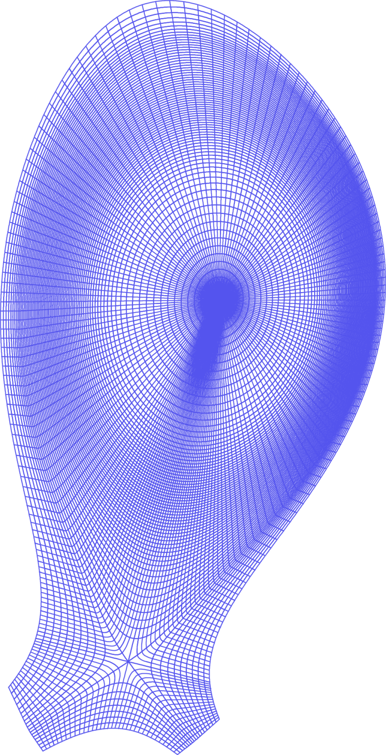
JOREK: Numerics
C¹ continuous 2D Bezier elements [O Czarny and G Huysmans, JCP 227, 7423 (2008)]
Flux-surface aligned X-point grid
Toroidal Fourier series
Fully implicit time stepping
GMRES iterative solver
Few library dependencies (HDF5, FFTW, Scotch, PaStiX)
MPI/OpenMP parallelization
Git repository with automatic tests and code reviewing

Slide 13
JOREK: Projects
EUROfusion Enabling Research
„Global non-linear MHD modelling in toroidal geometry of disruptions, edge localized modes, and techniques for their mitigation and suppression“ (PI M. Hoelzl)
„Understanding the role of reconnection in filament separation and its impact on plasma exhaust in tokamaks“ (PI S. Pamela)
Other EUROfusion work packages, ITER projects, HPC projects, …
Website https://www.jorek.eu

Slide 14
JOREK: Applications
Disruption physics
Tearing modes, Control via ECCD [D Meshcheriakov et al (in preparation)] [J Pratt et al, PoP (submitted)]
Thermal and current quench, massive gas injection, shattered pellet injection [E Nardon et al, PPCF 59, 014006 (2016)] [D Hu et al, 44th EPS, P2.142 (2017)]
Vertical displacement events [M Hoelzl et al, JPCS 561, 012011 (2014)] [FJ Artola et al (in preparation)]
Runaway electrons [C Sommariva et al, NF (submitted)] [V Bandaru, M. Hoelzl et al (unpublished)]
ELMs and their control – this talk (not able to show all activities of course) FJ Artola, M Becoulet, S Futatani, M Hoelzl, GTA Huijsmans, A Lessig, F Liu, F Orain, S Pamela, D van Vugt, …
[E Nardon, A Fil, M Hoelzl, GTA Huijsmans, JET Contributors, PPCF 59, 014006 (2017)]

Slide 15
Type-I ELMs:
How well reproduced?
Mode spectrum?
Loss mechanisms?

Slide 16
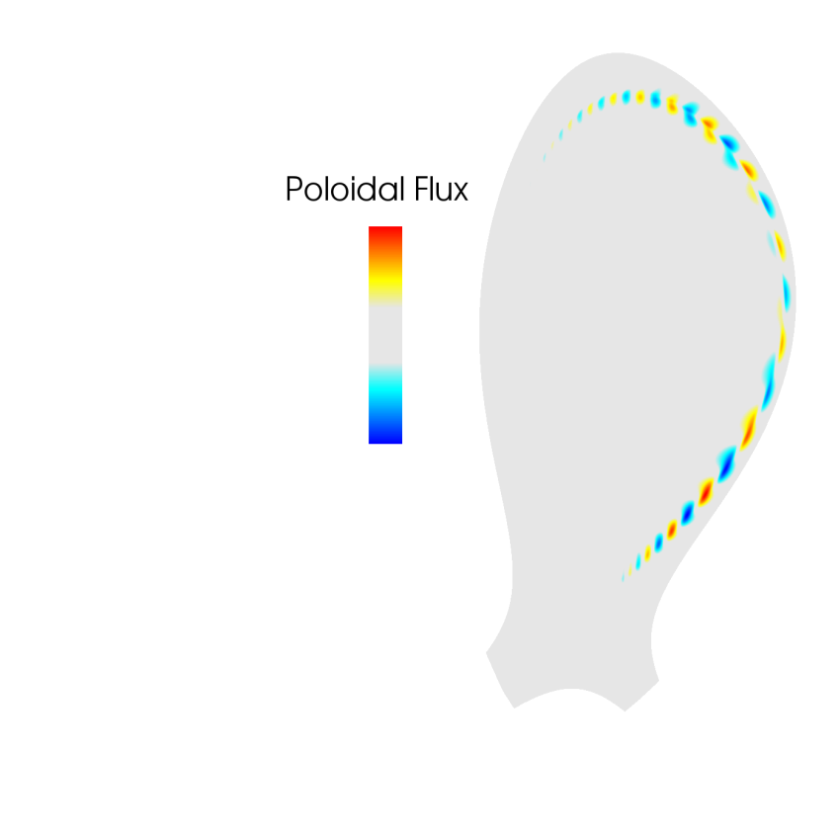
Linear instability
Simulations based on ASDEX Upgrade discharge #33616
Reduced MHD with diamagnetic and neoclassical flows
Spitzer resistivity increased by factor 8 for computational reasons
Experiment (magnetics): [F Mink, M Hoelzl, E Wolfrum et al, NF (submitted)]
Growth rate ${(5±2)∙10}^{4}s^{−1}$
Ballooning structure
Simulation:
Growth rate ${(4±1)∙10}^{4}s^{−1}$
Ballooning structure
Toroidal mode number n=6
✓

Slide 17
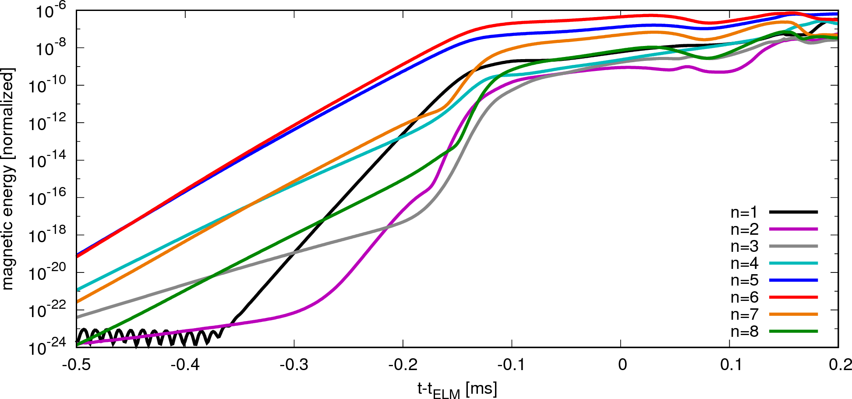
Non-linear mode coupling
Quadratic mode-coupling drives linearly stable low-n harmonics [I Krebs, M Hoelzl et al, PoP 20, 082506 (2013)]
Experiment:
Low-n structures during ELMs, e.g., in ASDEX Upgrade and TCV [RP Wenninger et al, NF 53, 113004 (2013)]
Evidence for mode coupling from bicoherence analysis [B Vanovac et al, 16th H-mode Workshop (2017), A7]
✓

Slide 18
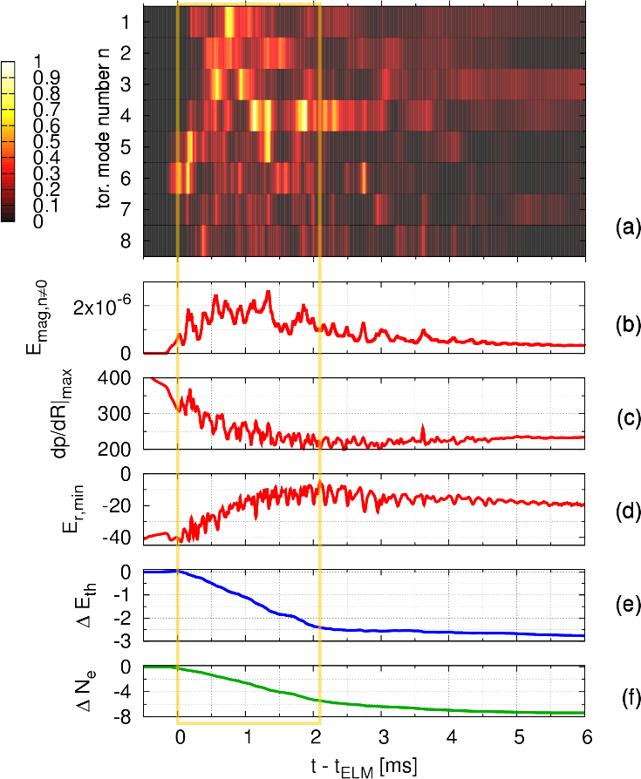
ELM crash in the simulation
Duration: ~2ms
Exp.: ~2ms
Dominant n: 4 (1…6 significant)
Exp.: 3 (2…5 significant)
E_{r} drop: -35 to -12 kV/m
Exp.: -40 to -10 kV/m
Particle losses: 7%
Exp.: 8%
Energy losses: 3%
Exp: 6%
✓
✓
✓
✓
?
Important role of ExB and diamagnetic flows as well as coupling to n=1

Slide 19
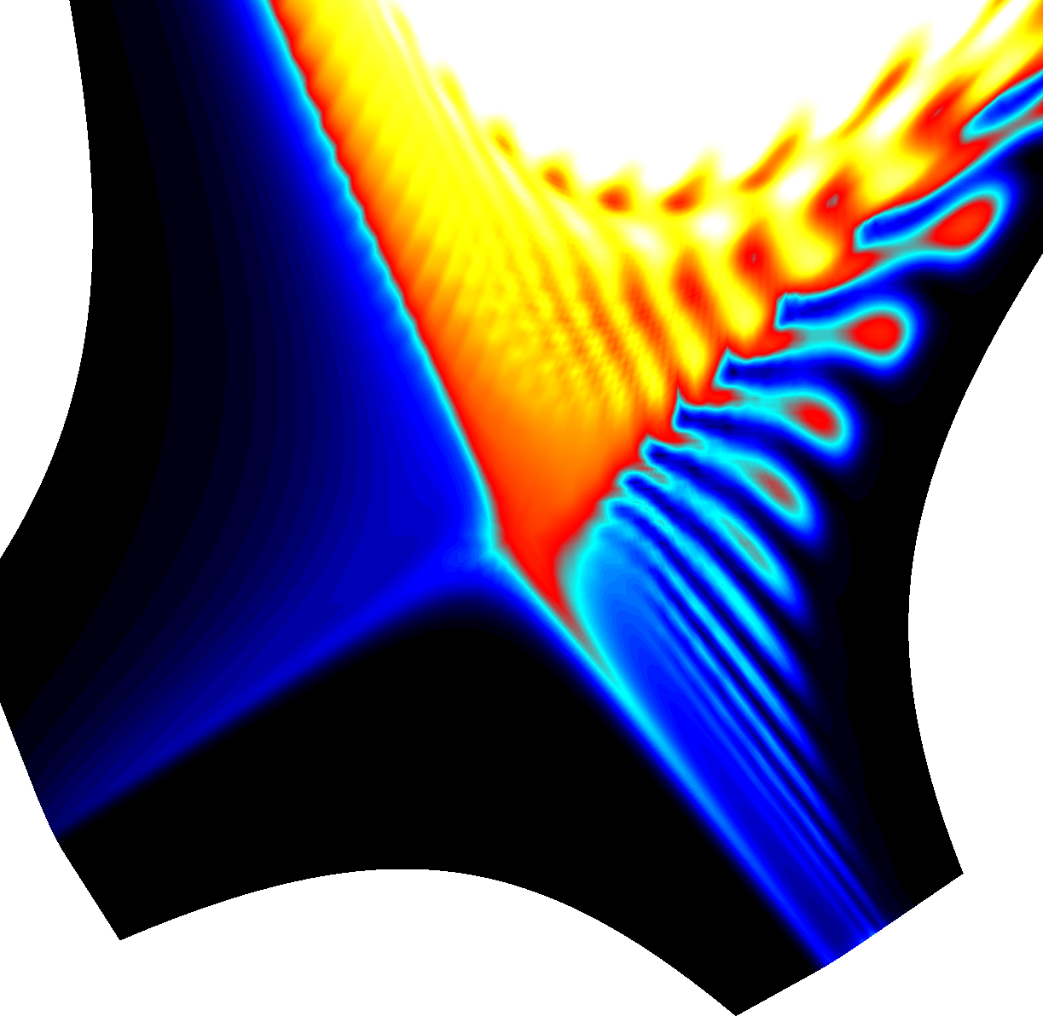
Kinetic perturbation: Filaments
Ballooning fingers are produced by interchange-like ExB inward and outward motion
Formation of filaments due to poloidal shear flows
Parallel losses from filaments to targets
Experiment:
Radial velocity ~1 km/s [A Schmid et al, PPCF 50, 045007 (2008)]
Several filament bursts during “long ELMs” [L Frassinetti et al, NF 57, 022004 (2017)]
✓
ASDEX Upgrade simulation without ExB/diamagnetic background flows
(see also movie)
✓

Slide 20
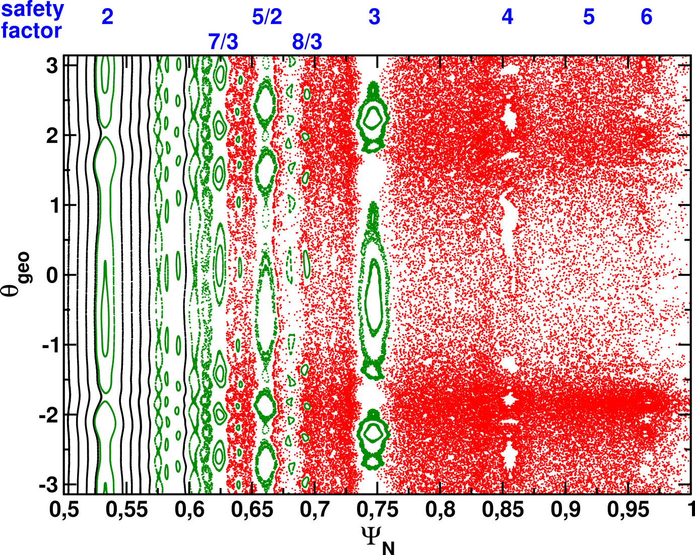
Magnetic perturbation: Ergodization
Magnetic perturbation leads to an edge stochastization
Direct connection to divertor targets along field lines
Parallel conductive losses affecting mostly electron temperature
Long-living core islands generated (NTM seeding)
KAM surfaces remain intact from q=3 inwards [AB Rechester, TH Stix, Phys.Rev.A 19, 1656 (1979)] [FA Volpe et al, NF 52, 054017 (2012)]
t-t_{ELM}=1.21ms

Slide 21
Magnetic perturbation: Ergodization
Magnetic perturbation leads to an edge stochastization
Direct connection to divertor targets along field lines
Parallel conductive losses affecting mostly electron temperature
Long-living core islands generated (NTM seeding)
KAM surfaces remain intact from q=3 inwards [AB Rechester, TH Stix, Phys.Rev.A 19, 1656 (1979)] [FA Volpe et al, NF 52, 054017 (2012)]
Direct connection to divertor
t-t_{ELM}=1.21ms

Slide 22
Cold front propagation
Connection length from the midplane to divertor targets
Cold front propagation in experiment [E Trier et al, NF (in preparation)]
Instantaneous → convection, first stochastic burst
Fast propagation → following front of stochastic region
Slow propagation → islands and local stochastization
L_{c} [km]
✓

Slide 23
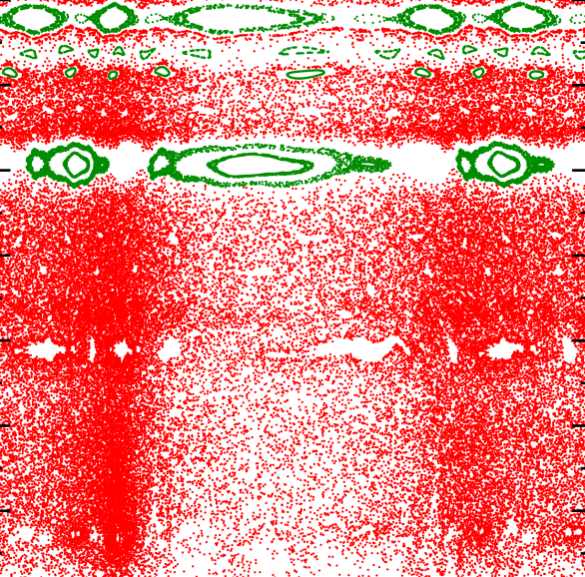
Cold front propagation
Connection length from the midplane to divertor targets
Cold front propagation in experiment [E Trier et al, NF (in preparation)]
Instantaneous → convection, first stochastic burst
Fast propagation → following front of stochastic region
Slow propagation → islands and local stochastization
L_{c} [km]
✓

Slide 24
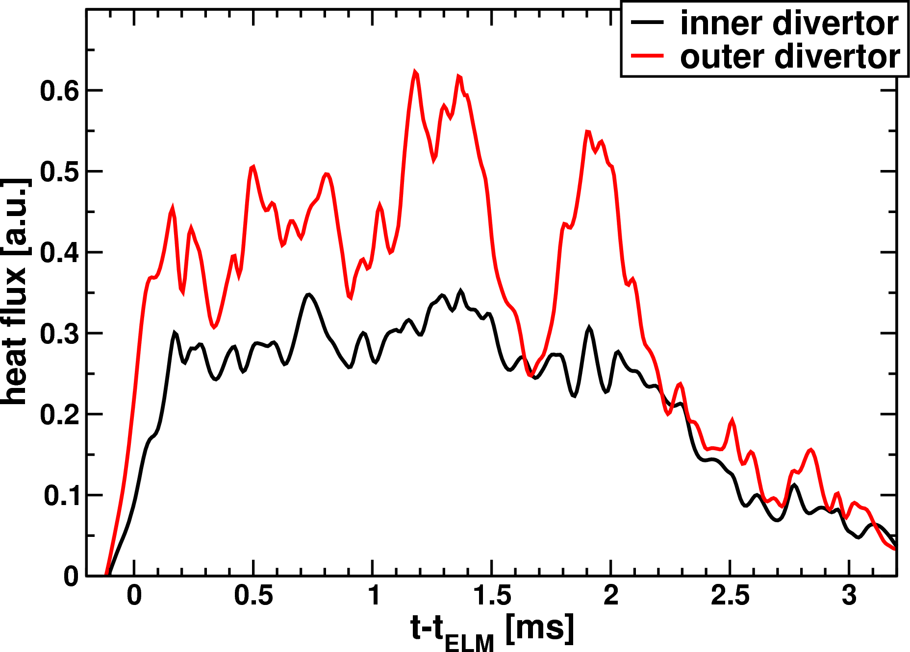
Divertor Heat Flux
Simulation:
60% to outer and 40% to inner divertor
Without background flows almost entirely to outer divertor
Weak toroidal asymmetry
Thermography measurements allow detailed comparisons, e.g., of the heat flux asymmetry between inner and outer divertor for different field directions
[T Eich et al, PPCF 47, 815 (2005)] [T Eich et al, J Nucl Mater 363-365, 989 (2007)] [T Eich et al, J Nucl Mater 390-391, 760 (2009)]

Slide 25
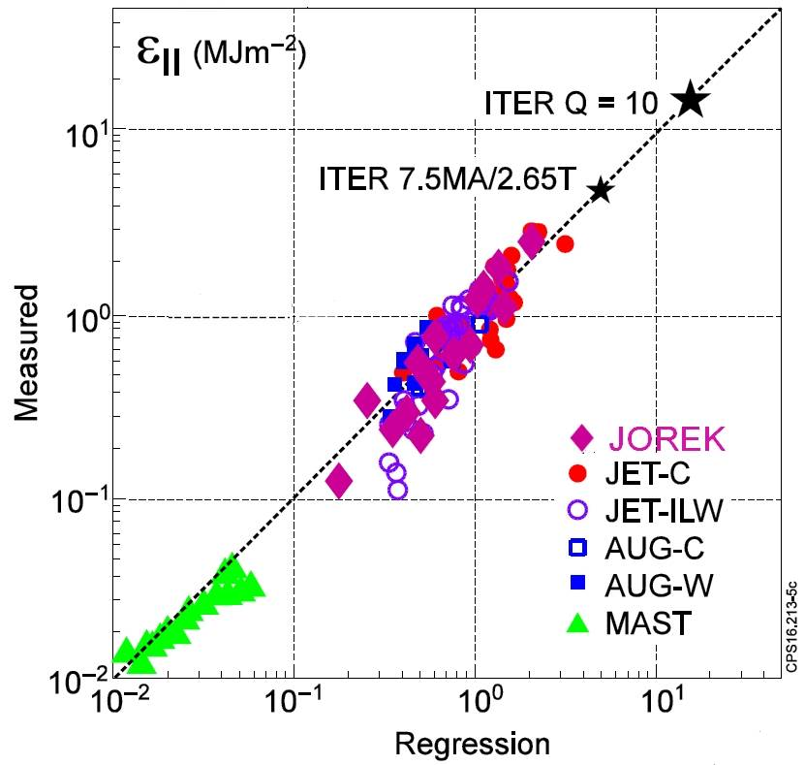
Peak energy fluence to the divertor
“ELM energy fluence is about proportional to pedestal top pressure as well as to the linear machine size and dependent on the square root of the relative ELM size” [T Eich et al, submitted]
Series of JET simulations fits very well with the experiment [S Pamela et al, NF 57, 076006 (2017)]
However, simulations including neoclassical and diamagnetic flows tend to systematically underestimate losses
✓
?

Slide 26
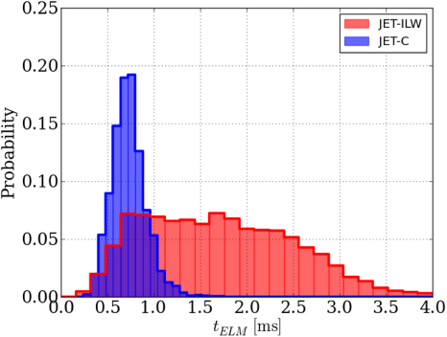
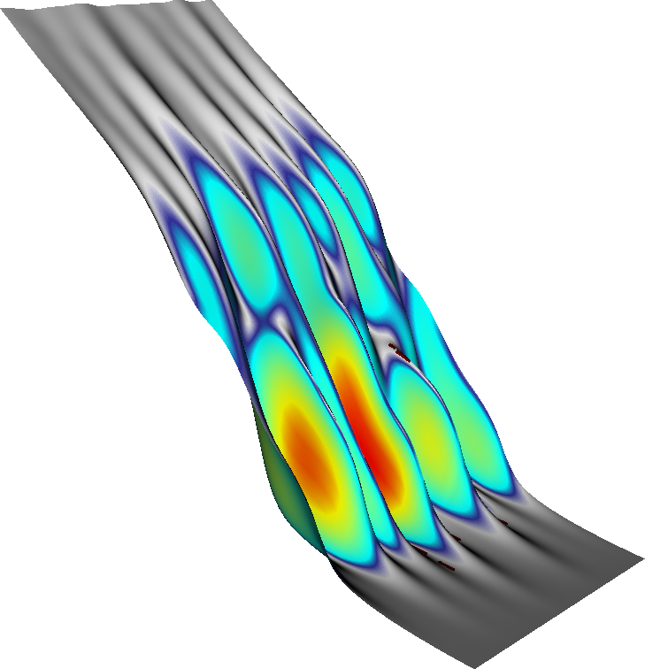
Decay of the instability
Decay well below stability threshold
Short and long ELMs in experiment [L Frassinetti et al, NF 57, 022004 (2017)] [B Sieglin et al, PPCF 55, 124039 (2013)]
Stabilizing: Pedestal pressure gradients and current densities drop
Destabilizing: Large local gradients, ExB and diamagnetic flows decrease
t-t_{ELM}=1.88ms

Slide 27
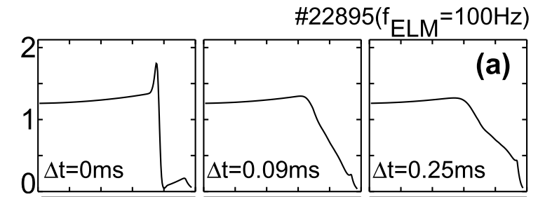
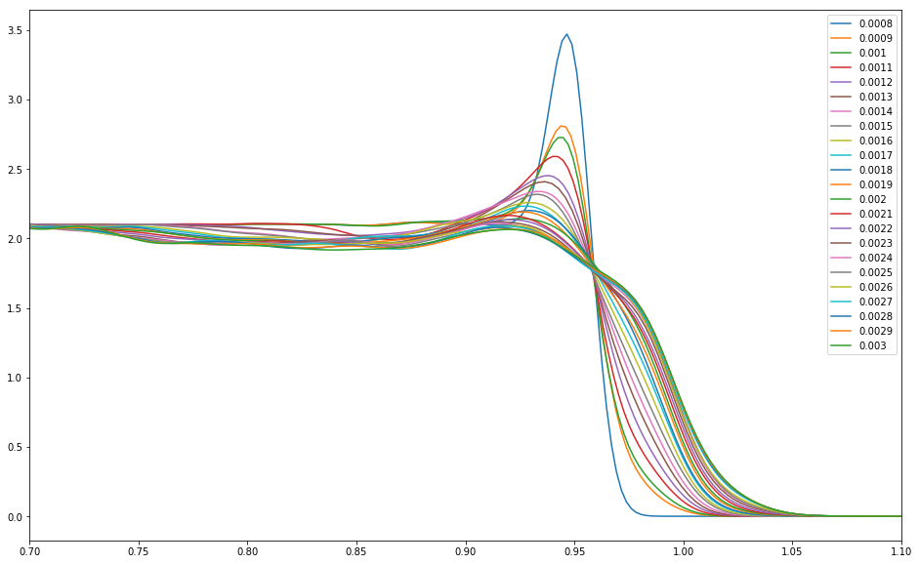
Tungsten exhaust
[R Dux et al, NF 51, 053002 (2011)]
[DC van Vugt, GTA Huysmans, M Hoelzl et al, NF (in preparation)]
Tungsten transport in ASDEX Upgrade ELM case
Mixing due to perturbation of E-field (Preliminary results)

Slide 28
Control:
Which methods are under investigation?

Slide 29
Quiescent H-Mode: A natural ELM-free regime

Slide 30
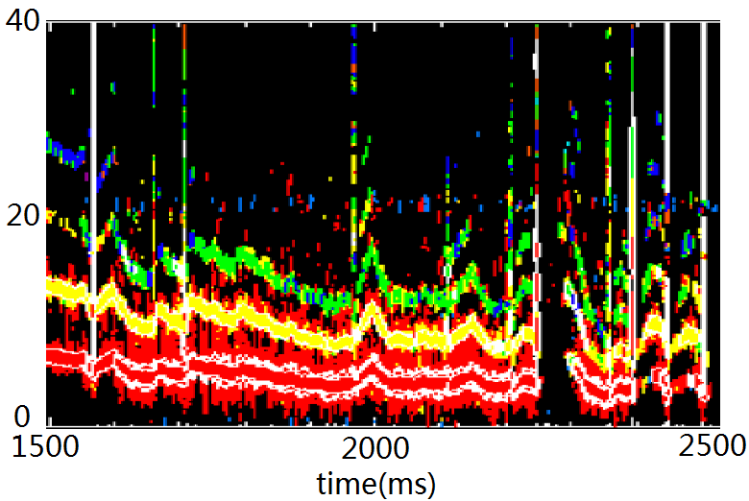
Quiescent H-Mode
First observed in DIII-D [CM Greenfield et al, PRL 86, 4544 (2001)]
Key: Plasma shaping, shear flows, and field direction
Density shows “Edge harmonic oscillation” (EHO)
DIII-D #145117
f(kHz)

Slide 31
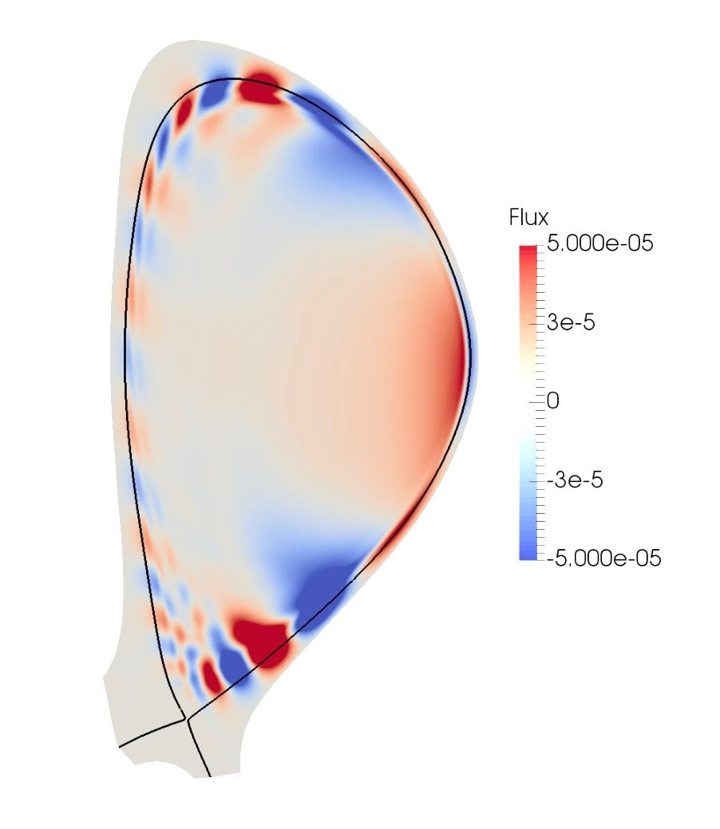
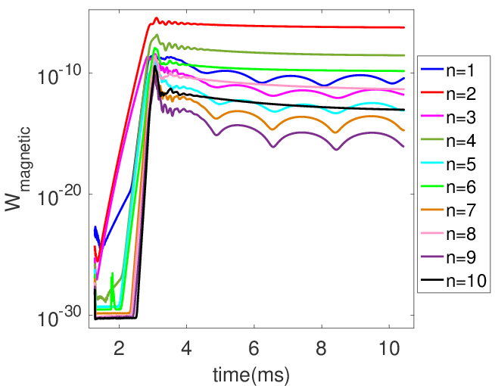
Simulations for DIII-D
Large edge current density and strong ExB shear: Saturated kink-peeling modes with low toroidal mode numbers
Toroidally localized density oscillation similar to EHO [F Liu et al, PPCF (submitted)] [F Liu et al, NF 55, 113002 (2015)]
✓

Slide 32
ELM pacing by pellet injection

Slide 33
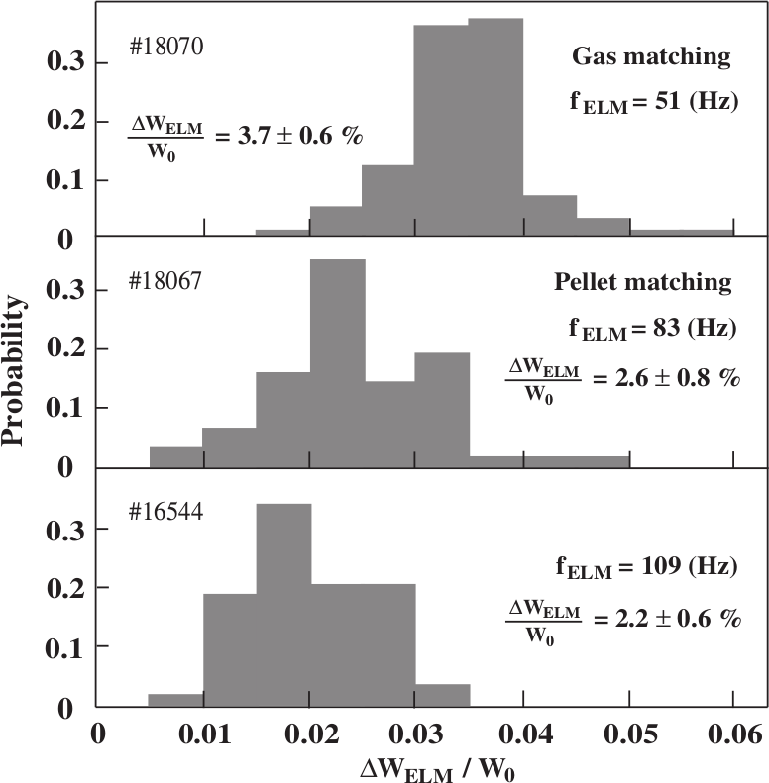
ELM pacing in the experiment
ELM size can be reduced by pellet pacing $W_{ELM}∙f_{ELM}≈constant$ [P Lang et al, NF 44, 665 (2004)]
Peak heat flux reduced?
Pellet size, injection geometry and velocity, efficiency in ITER?

Slide 34
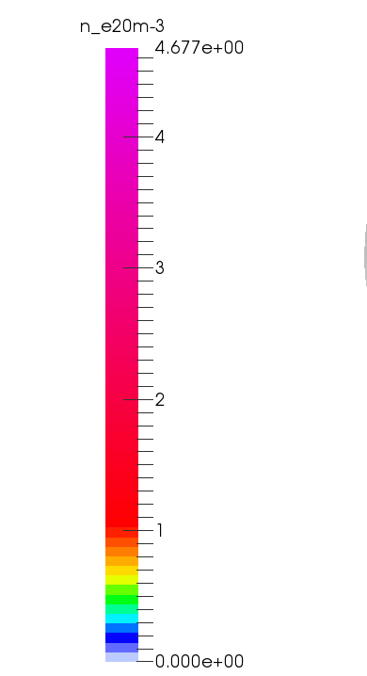
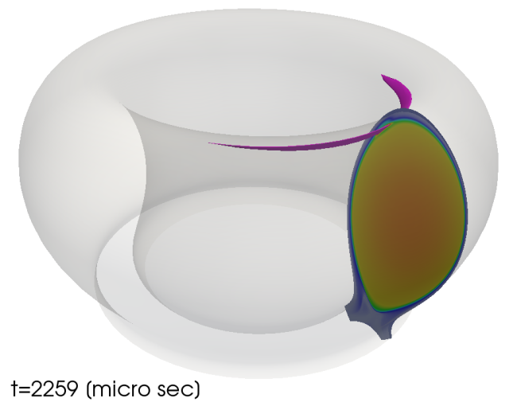
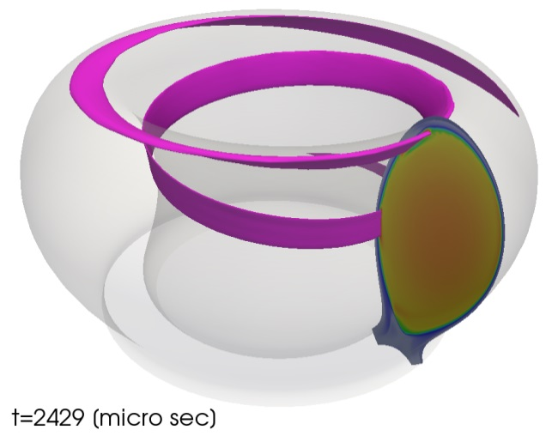
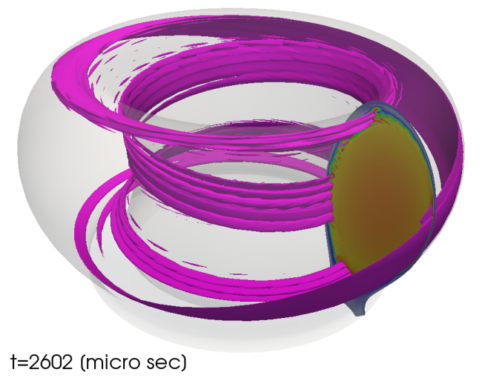
Basic mechanism
Pellet cloud: Density increases and temperature drops
Local re-heating by parallel transport
Local pressure gradient increases
3D pressure perturbation destabilizes ballooning modes [S Futatani, G Huysmans, et al, NF 54, 073008 (2014)]
n_{e}
[normalized]
Example of a pellet cloud in ASDEX Upgrade [S Futatani, M Hoelzl et al, PoP (in preparation)]

Slide 35
Destabilization of an ELM
Pellet size for triggering ELMs in DIII-D well reproduced
[S Futatani, G Huysmans, et al, NF 54, 073008 (2014)]

Slide 36
ELM pacing by vertical magnetic kicks

Slide 37
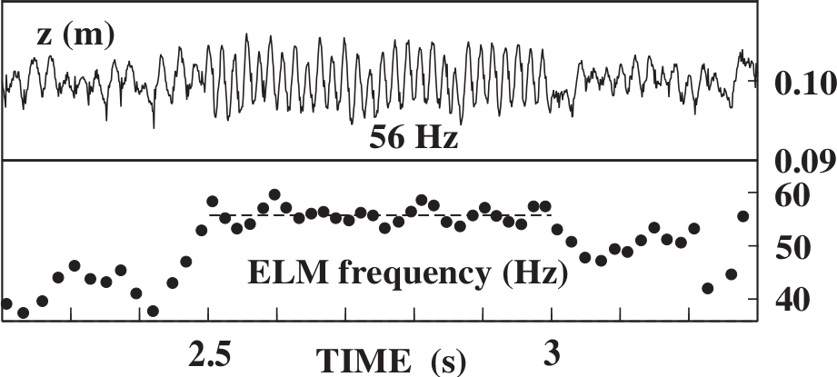
Vertical kick ELM triggering
Pacing of ELMs via vertical magnetic kicks first demonstrated in TCV [AW Degeling, PPCF 45, 1637 (2003)]
[PT Lang et al, PPCF 46, L31 (2004)]
Pressure/current driven beyond stability threshold
Could be an option for ITER up to ~10 MA based on scaling from present experiments

Slide 38
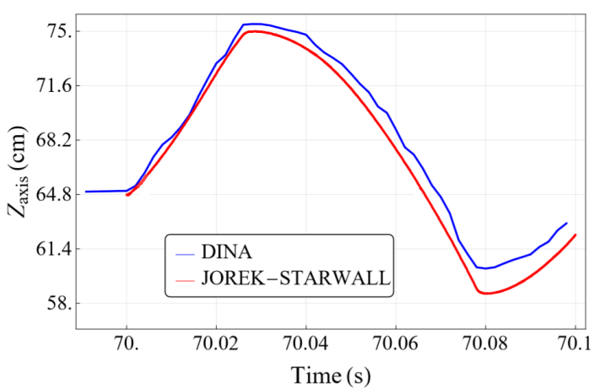
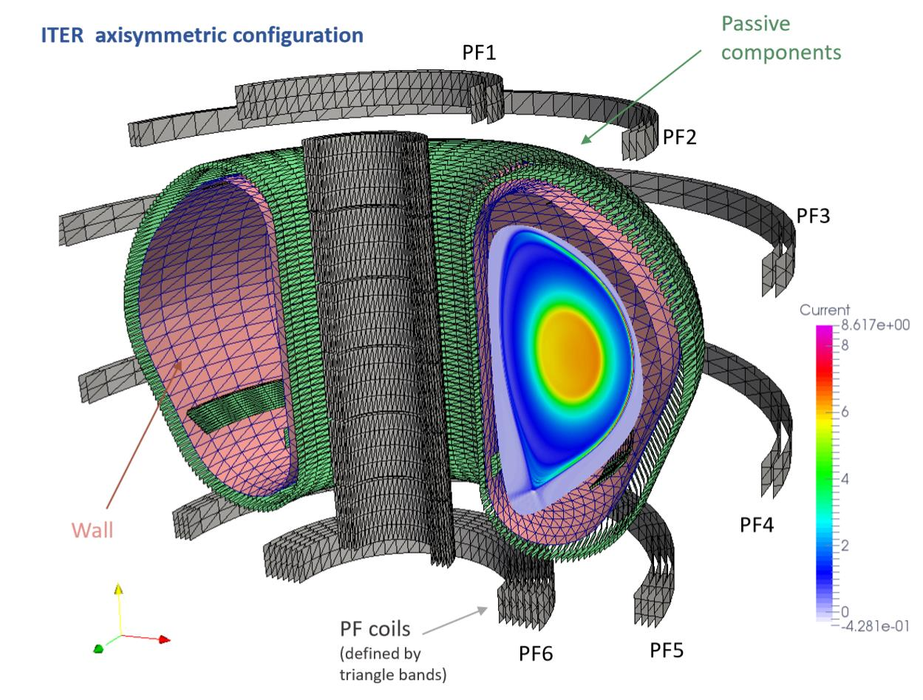
Simulation of kick ELM triggering
Using free boundary JOREK-STARWALL
Benchmark against DINA code for realistic ITER 7.5MA/2.65T configuration
→ Poster P2-02 by FJ Artola
[FJ Artola, P Beyer, M Hoelzl, GTA Huijsmans, A Loarte (in preparation)]

Slide 39
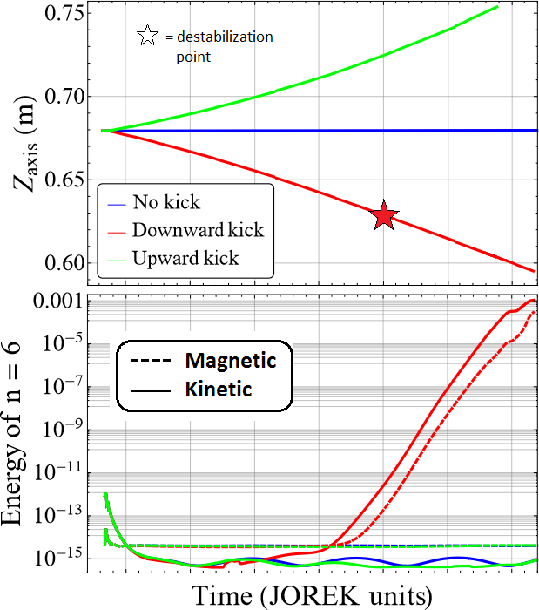
Simulation of kick ELM triggering
Edge current induction
Destabilization of ELM
Destabilization at same Z_{axis} location independent of the kick frequency (see also movie)
→ Poster P2-02 by FJ Artola
[FJ Artola, P Beyer, M Hoelzl, GTA Huijsmans, A Loarte (in preparation)]

Slide 40
ELM mitigation and suppression by resonant magnetic perturbation fields

Slide 41
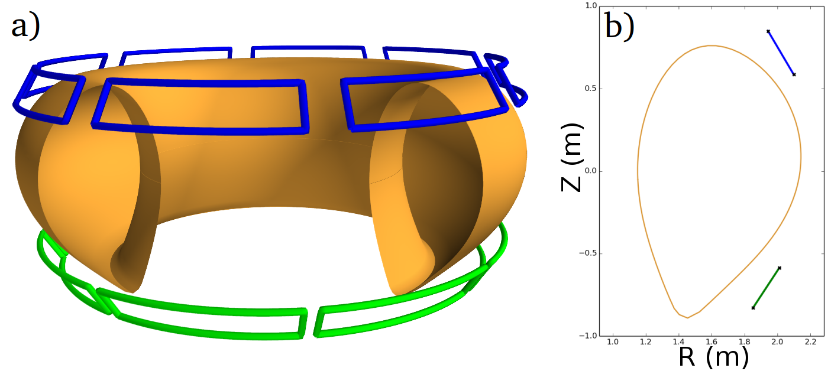
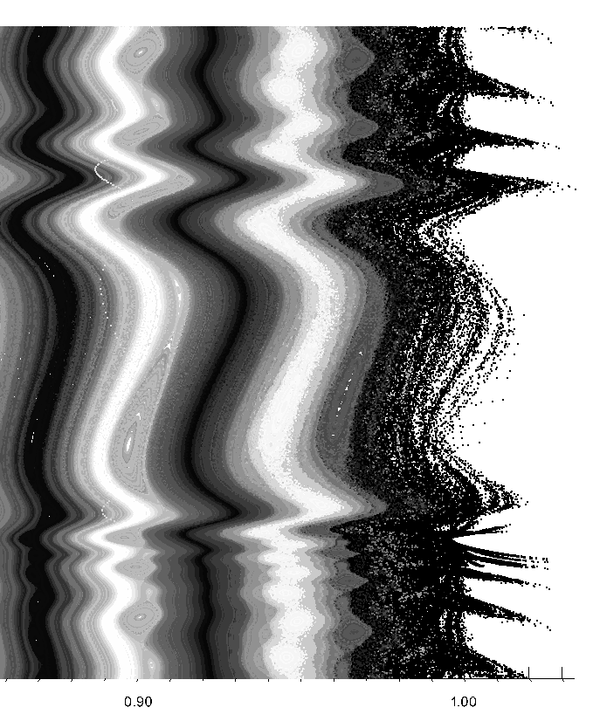
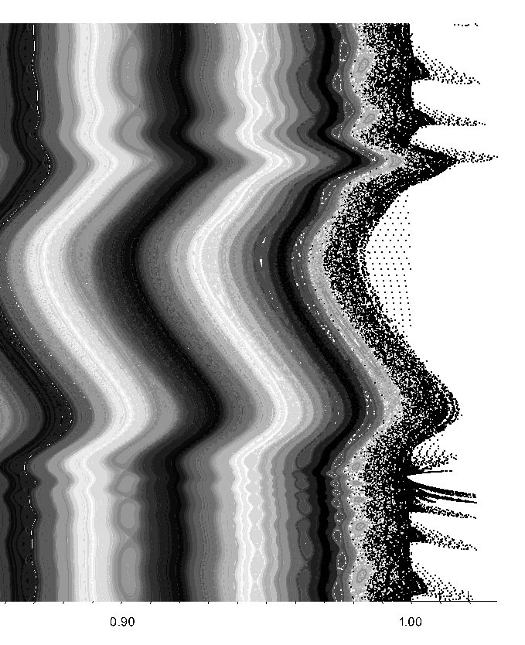
Penetration of n=2 RMP fields
π
ΔΦ=+90°
ΔΦ=-90°
ΔΦ
θ
ΔΦ: phase between upper and lower coils
x
x
-π
0.9 ψ 1
0.9 ψ 1
“Resonant”
“Non-Resonant”
Larger stochastic region, stronger kinking at X-point
Coupling of kink and tearing modes amplifies resonant response [M Becoulet et al, PRL 113, 115001 (2014)] [F Orain, M Hoelzl et al, NF 57, 022013 (2016)]
3D displacement of flux surfaces in line with experiments [M Willensdorfer et al, NF 57, 116047 (2017)]

Slide 42
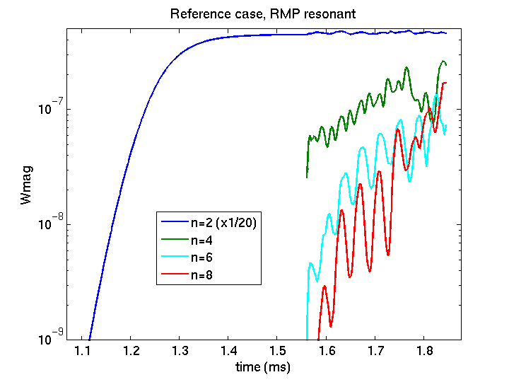
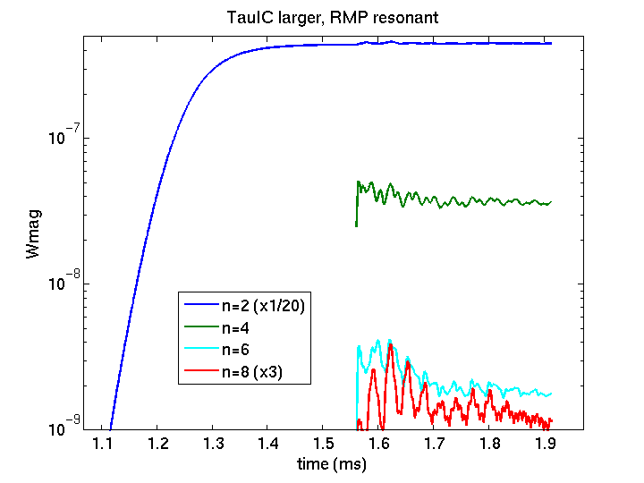
ELM RMP interaction
Without RMP fields (simulation for ASDEX Upgrade ELM mitigation scenario) → Large ELM instability
Resonant RMP fields → Lower growth rate and saturation level
By 20% enhanced flows → Only static modes driven by RMPs
RMPs on
Add n>2
modes
Suggests an important role of non-linear mode coupling for mitigation/suppression
[F Orain, M Hoelzl et al (in preparation)]

Slide 43
Conclusions

Slide 44
Conclusions / Outlook
JOREK: the European non-linear MHD code for large-scale instabilities in tokamak X-point plasmas investigating disruption and ELM physics
ELM simulations in line with experiments in key aspects
Full ELM cycle? Short and long ELMs? Small ELM regimes?
Many aspects of QH-Mode reproduced by simulations
Physics origin of ELM and ELM free regimes?
Pellet ELM triggering well understood
Peak heat loads?
First simulations of kick ELM triggering (►Poster P2-02)
Comparison to existing experiments
Mitigation and suppression by RMP coils simulated
Pump-out vs mode coupling?
Extrapolation to ITER?

Slide 45
Backup Slides

Slide 46
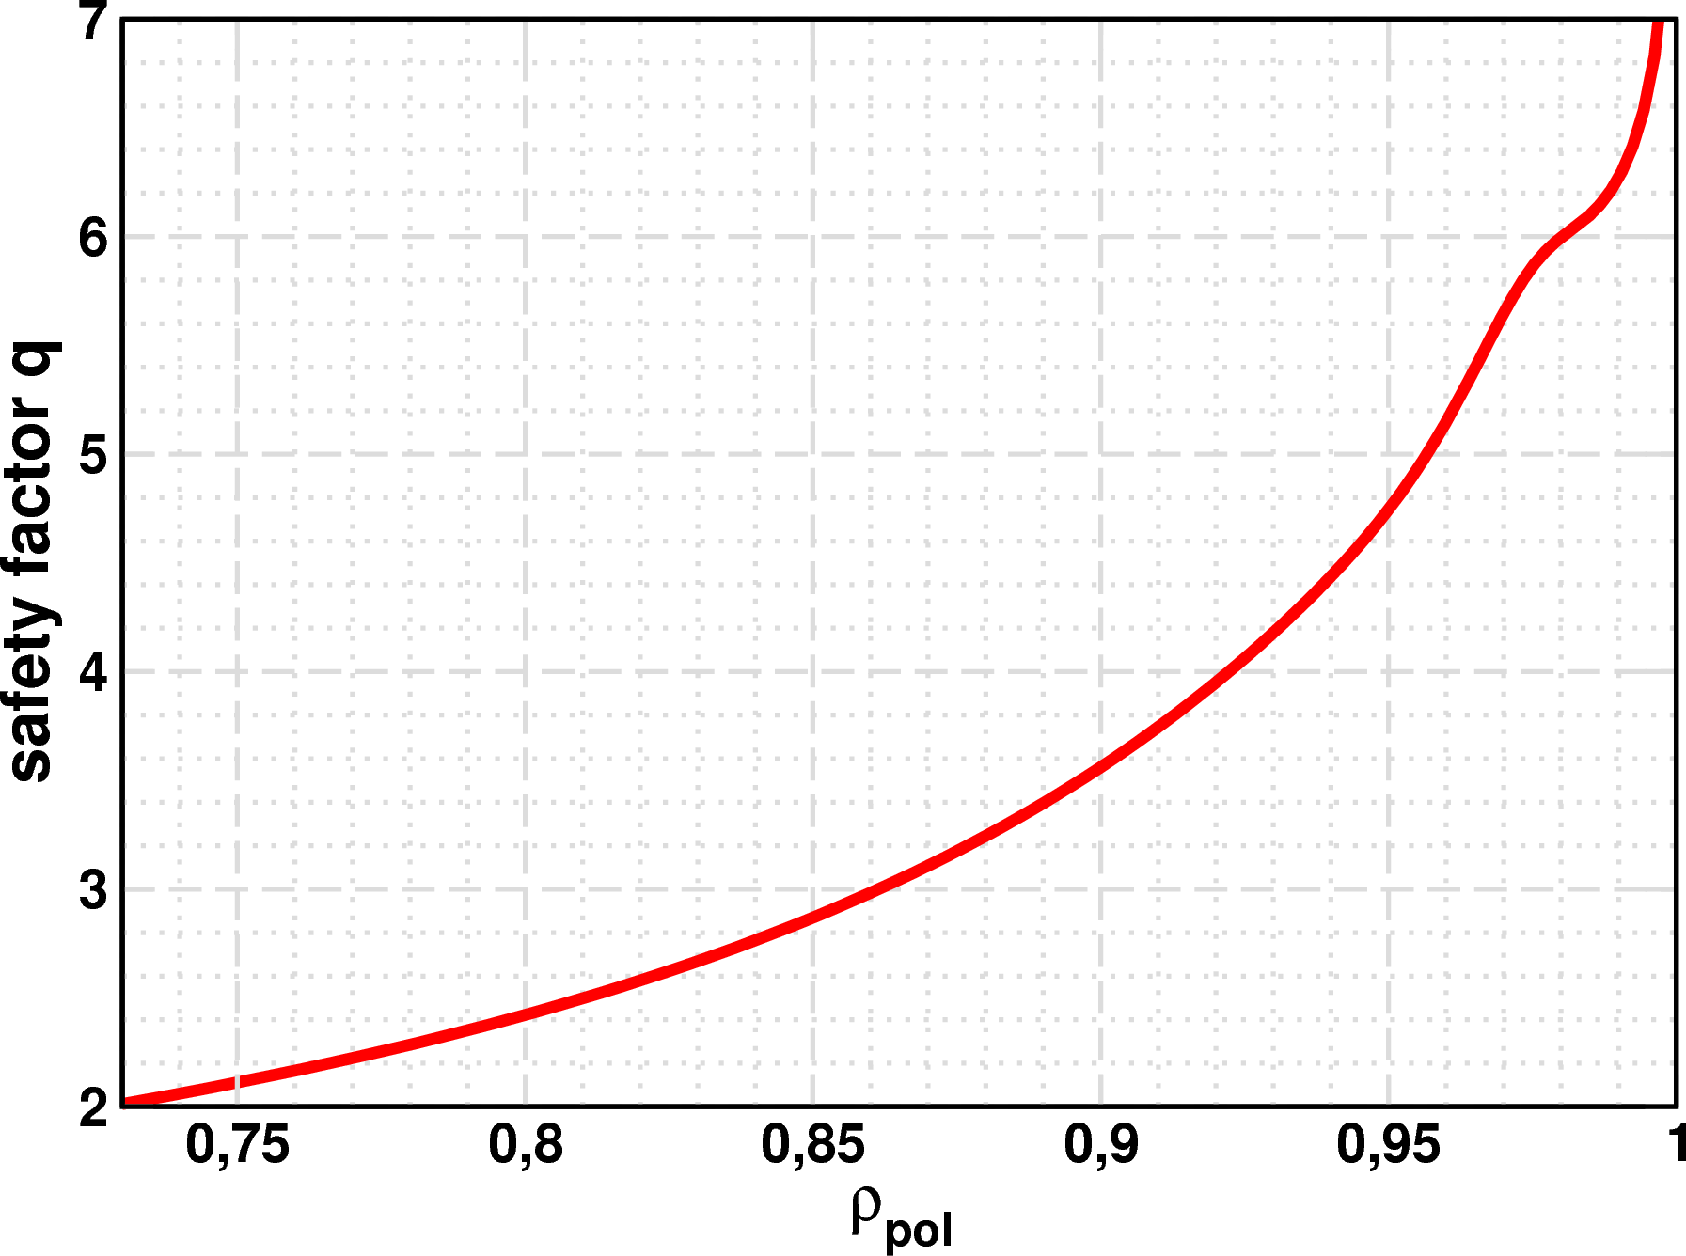
ASDEX Upgrade equilibrium
R | Psi_N | Rho_pol | q
2.05 | 0.70 | 0.835 | 2.7
2.06 | 0.73 | 0.85 | 2.9
2.07 | 0.76 | 0.87 | 3.1
2.08 | 0.79 | 0.89 | 3.4
2.09 | 0.82 | 0.905 | 3.7
2.10 | 0.85 | 0.92 | 4.0
2.11 | 0.89 | 0.94 | 4.5
2.12 | 0.92 | 0.96 | 5.1
2.13 | 0.95 | 0.975 | 5.9
2.14 | 0.98 | 0.99 | 6.3

Slide 47
Cold front penetration in experiment
[E Trier et al, NF (submitted)]

Slide 48
[F Mink, E Wolfrum, M Hoelzl, et al, 16th H-mode Workshop, St. Petersburg (2017)]

Slide 49
Kick ELM triggering
[FJ Artola et al]

Slide 50
Kick ELM triggering
[FJ Artola et al]

Slide 51
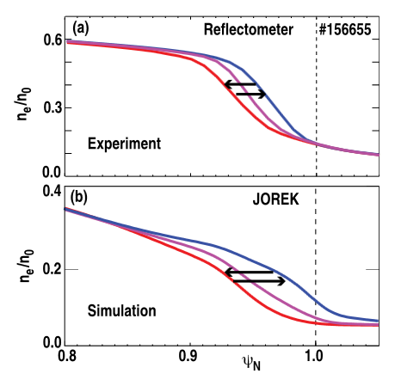
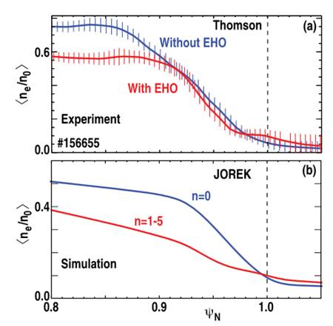
QH-Mode
[F Liu et al]

Slide 52
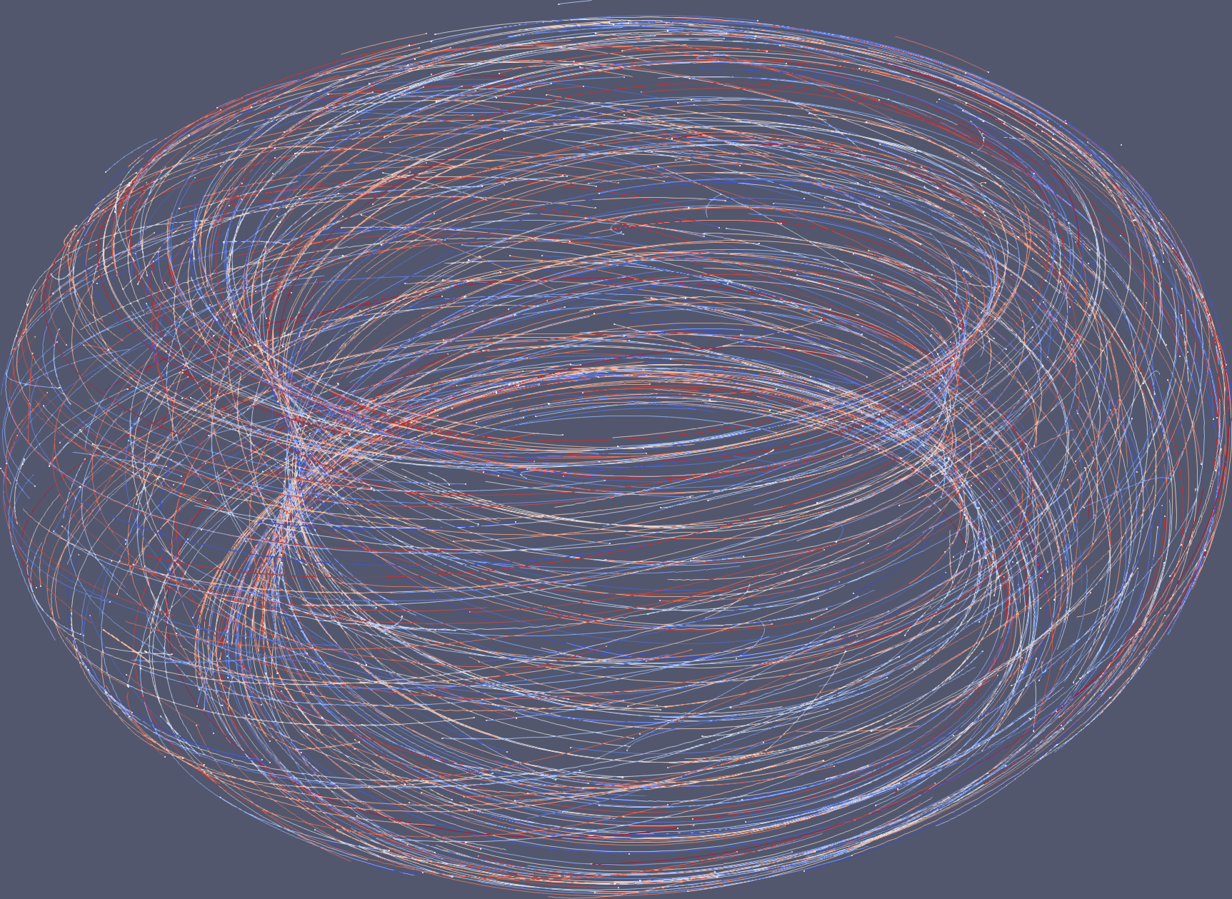
JOREK kinetic particle extension
[D van Vugt et al]
Couple JOREK MHD solver with particle tracking code
Follow particles in time-varying electromagnetic fields
6D Full-Kinetic (Boris method)
5D Fieldline tracer (Adams-Bashforth, forward Euler)
Ionisation/recombination with OPEN-ADAS coefficients
Particle-background collisions with binary collision model
Feed-forward now, feedback to MHD underway
Applications:
W impurity transport (in ELMs)
W radiation impact on MHD
Fast ions, impact on MHD (A. Dvornova)
Runaway electrons (C. Sommariva)
Delta-f contribution in MHD equations
Divertor physics
Notes:
JOREK has already been introduced by this point I guess?

Slide 53
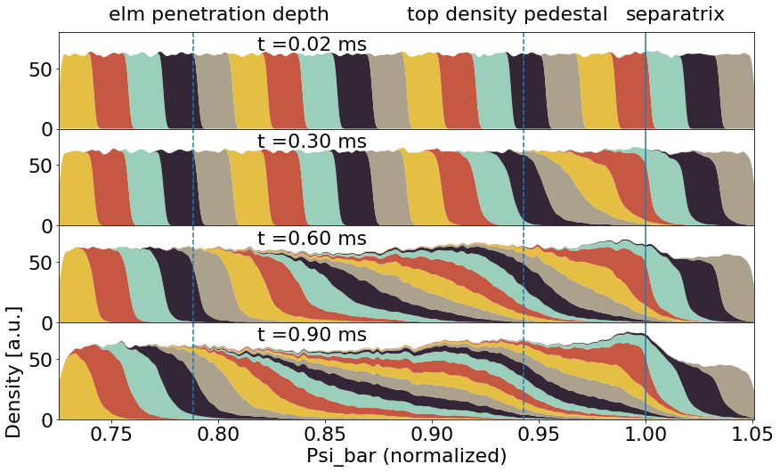

Slide 54
Neoclassical tearing mode seeding
Seed island size for NTMs in ASDEX Upgrade expected to be around 1cm [A Gude et al, NF 39, 127 (1999)]
ELMs can seed NTMs, e.g., in ASDEX Upgrade [S Fietz et al, PPCF 55, 085010 (2013)]
ASDEX Upgrade simulations show formation of 2/1 and 3/2 islands roughly of this size
Non-linear mode-coupling producing low-n is crucial
NTM seeding could be cumulative effect of several successive ELM crashes, which have “correct” phases to further amplify island beyond critical island size
Mode coupling might influence the phasing of ELM

Slide 55
Non-linear mode coupling
Non-linear terms allow a coupling of toroidal harmonics n₂ and n₃ to n₁=n₂±n₃ since sin(α±β)=sin(α)cos(β)±cos(α)sin(β)
A simple model is sufficient to describe the early non-linear phase of an ELM crash
Linear growth rates taken from JOREK
Coupling coefficients via fitting
[I. Krebs, M. Hoelzl et al, PoP 20, 082506 (2013)]

Slide 56
JOREK equations

